Slide 1
FINAL PROJECT PROPERTY INSURANCE PROCESSING SYSTEM
JCL,VSAM,GDG,COBOL,DB2
Presented by : DivyaBharathi R T
Emp ID: 2400703

Slide 2
INTRODUCTION
Allianz Insurance Company is a leading insurance company in India. It offers various types of Policies for its customers. Due to large amount of data, the insurance company plans to automate it processes. For this purpose it needs to store all the details in different databases like Policy Database and Agent Database. so the main objective of this project is to store the insurance policy details in the database system.

Slide 3
PART 1: VALIDATION
INPUT FILES
1. INSURANCE POLICY FILE (TECN021.DIVYA.IPOLICY.FILE)
2. AGENT DETAILS FILE
(TECN021.DIVYA.AGENT.PS)
VALIDATION OF THE RECORDS

Slide 4
PART 2: INSERTION OF RECORDS
INSERT THE VALID RECODS INTO
INSURANCE POLICY DATABASE(INSURANCE_POLICY)
VSAM FILE(TECN021.DIVYA.IPOLICY.KSDS)
O/P FILE(TECN021.DIVYA.TEM.PS)
AGENT DETAILS DATABASE(AGENT_DETAILS)
ERROR FILES
TECN021.DIVYA.ERR.PS
TECN021.DIVYA.ERRAG.PS
INSERT THE INVALID RECORDS INTO

Slide 5
PART 3: GENERATION OF REPORT FILE
EXTRACTION THE REQUIRED DETAILS FROM O/P FILE(TECN021.DIVYA.TEM.PS)
GENERATE A SEPARATE REPORT FILE(TECN021.DIVYA.REPORT.PS)
PART 4: DGD BACKUP
BACK UP OF ALL THE INPUT AND OUTPUT FILES IN GDG FILE WITH GDG LIMIT OF 14 VERSIONS

Slide 6
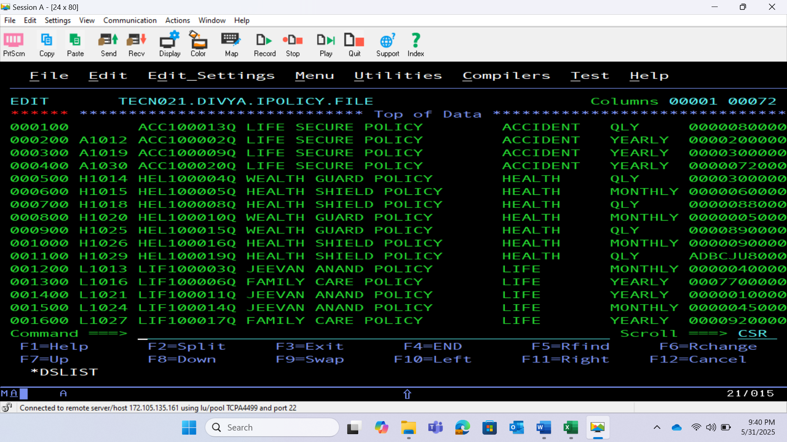
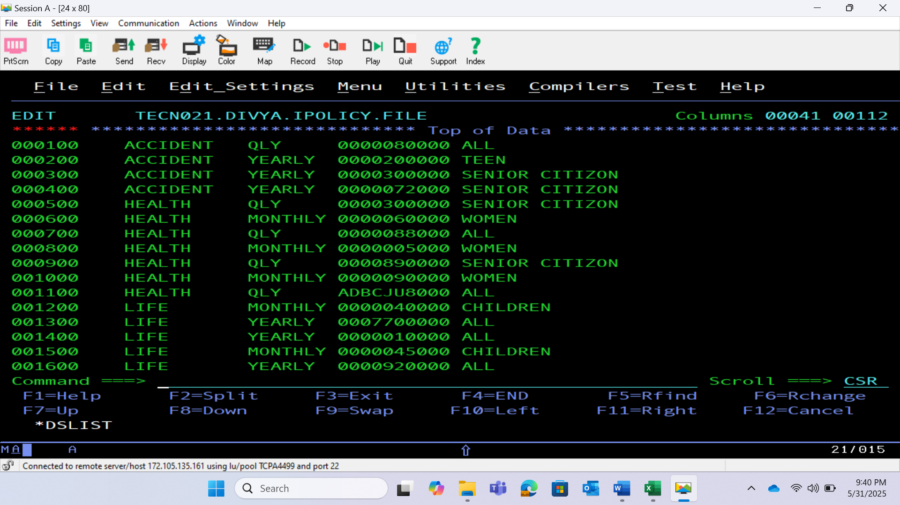
INPUT PS-1

Slide 7
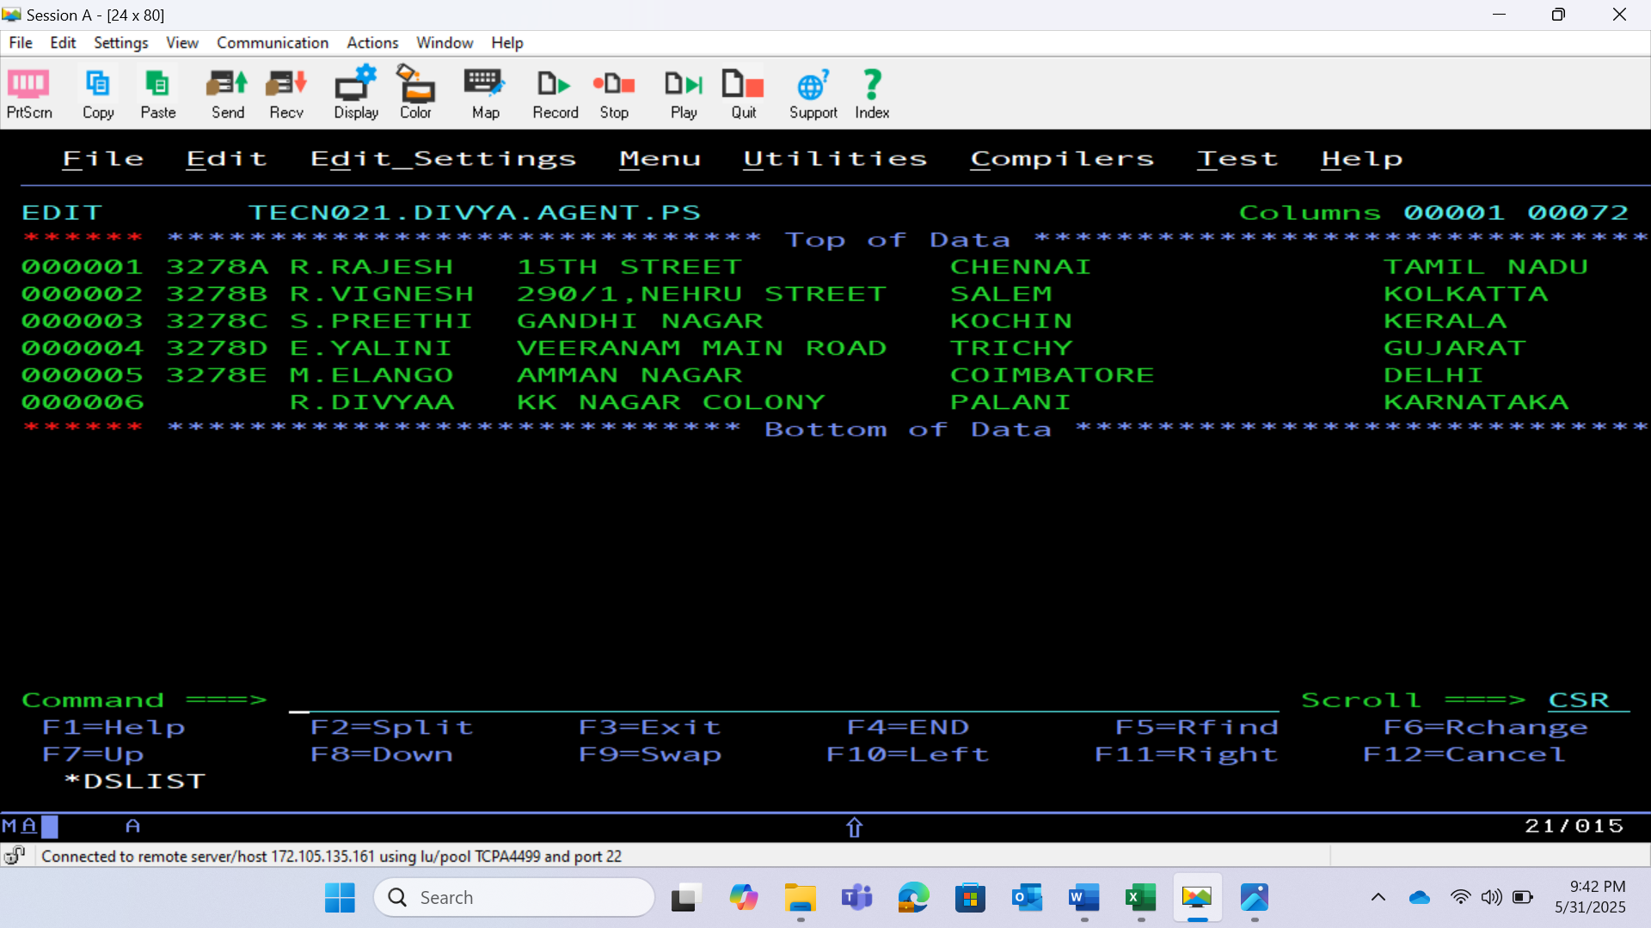
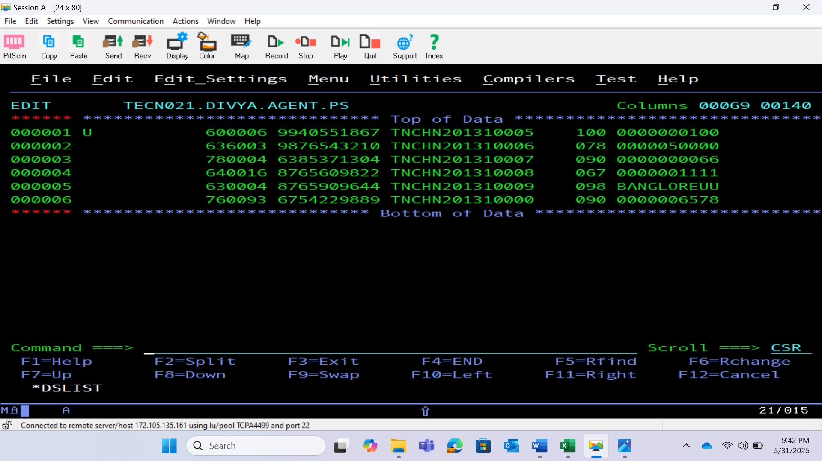
INPUT PS-2

Slide 8
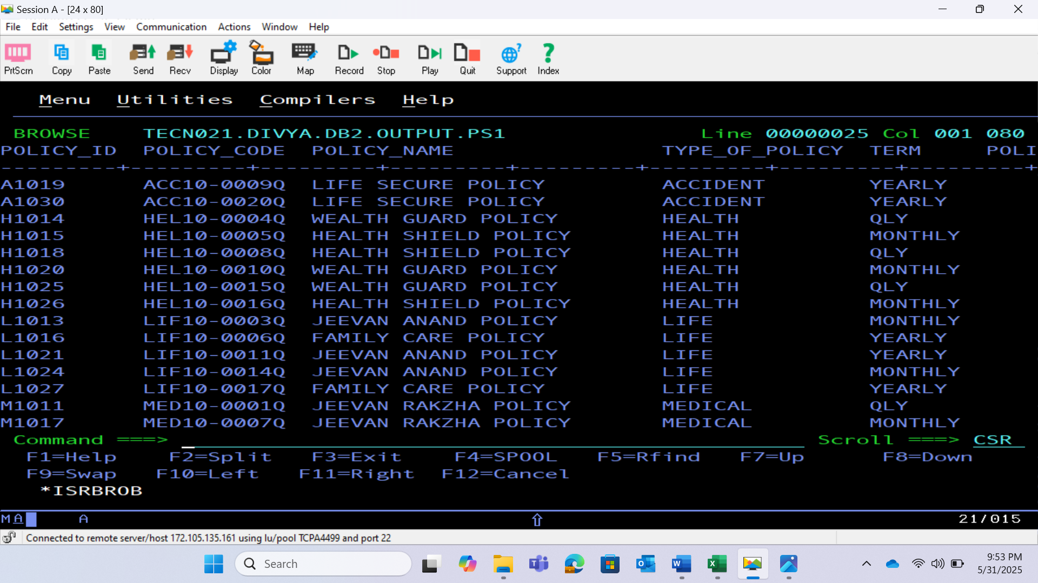
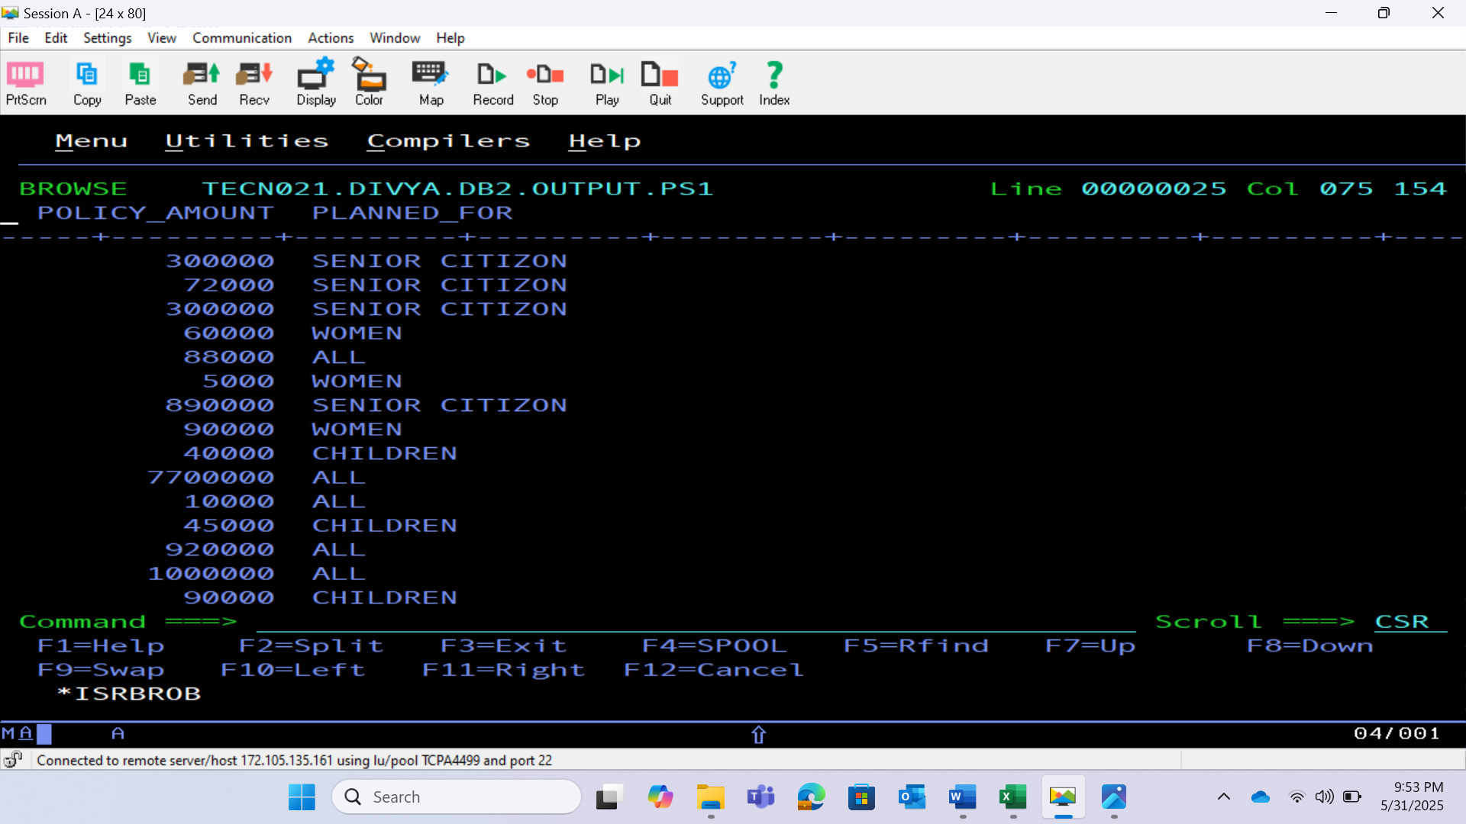
INSURANCE POLICY TABLE

Slide 9
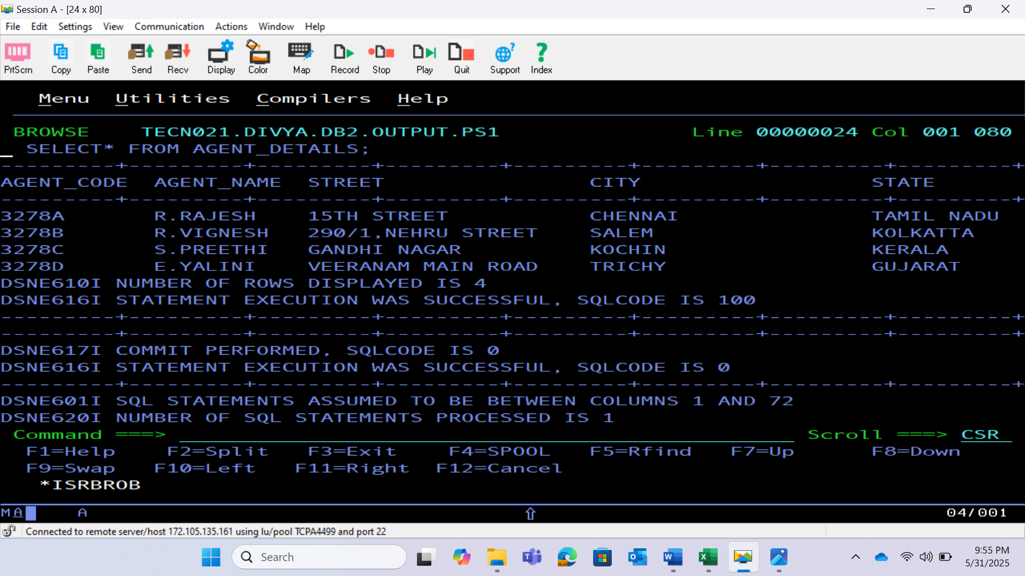
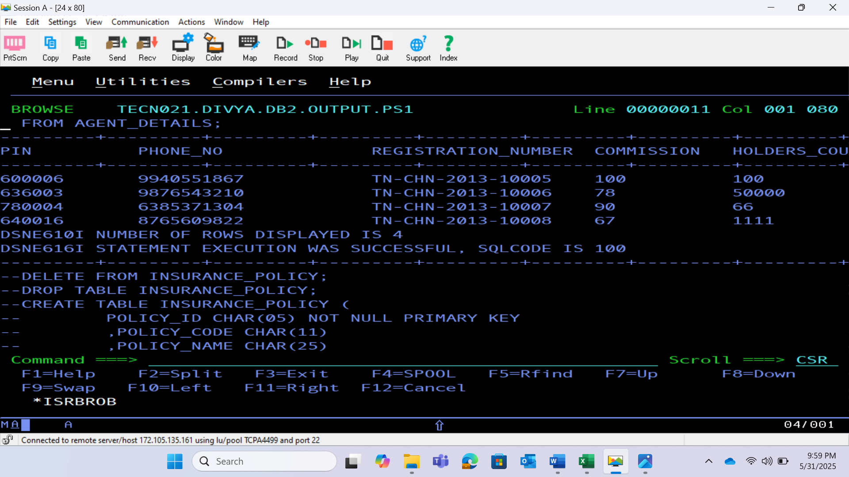
AGENT DETAILS TABLE

Slide 10
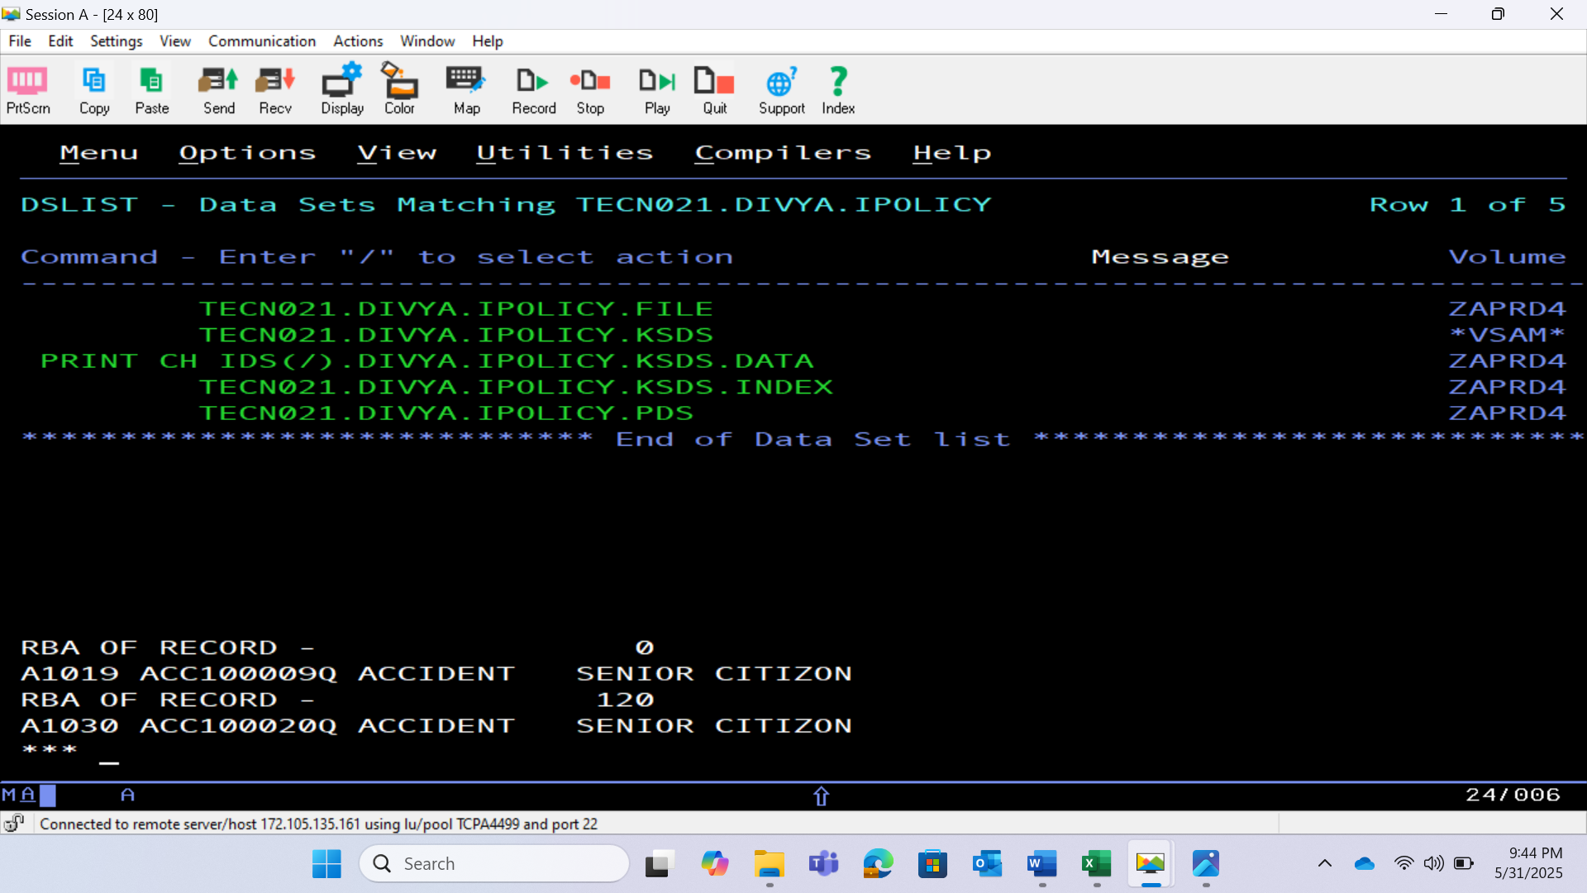
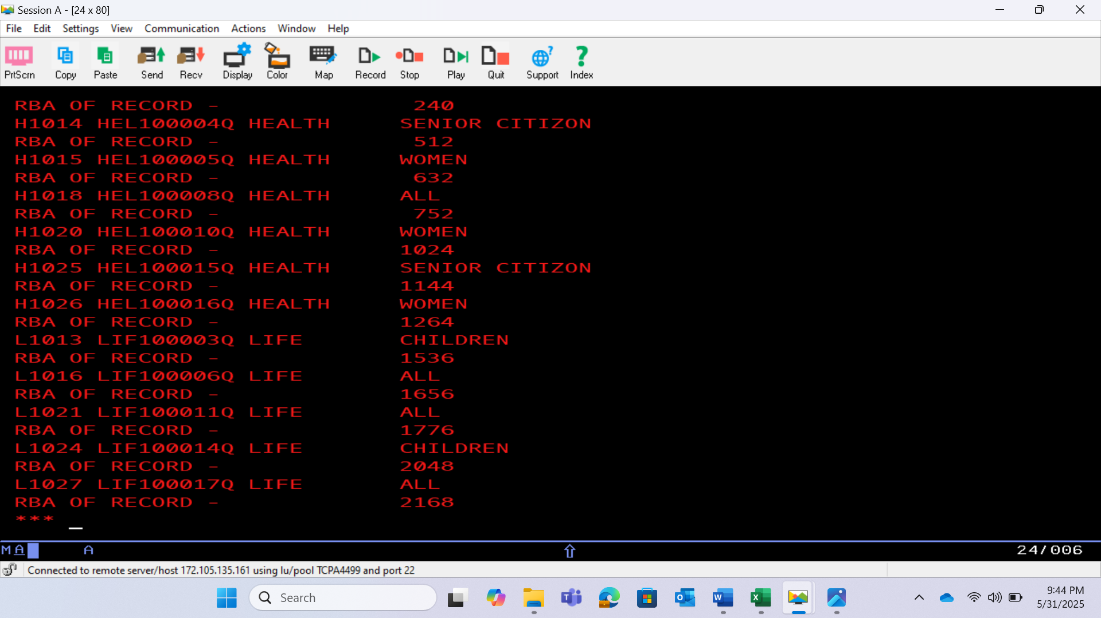
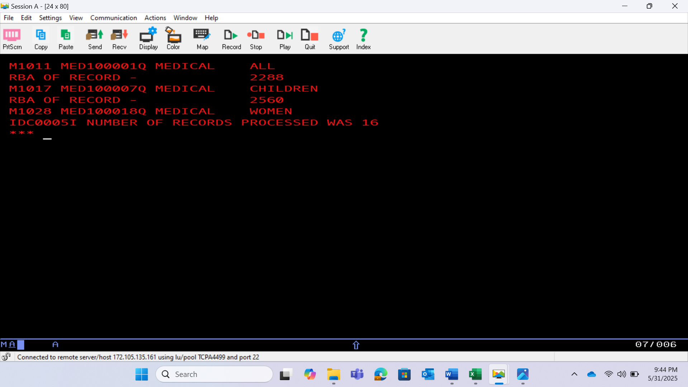
VSAM(KSDS)

Slide 11
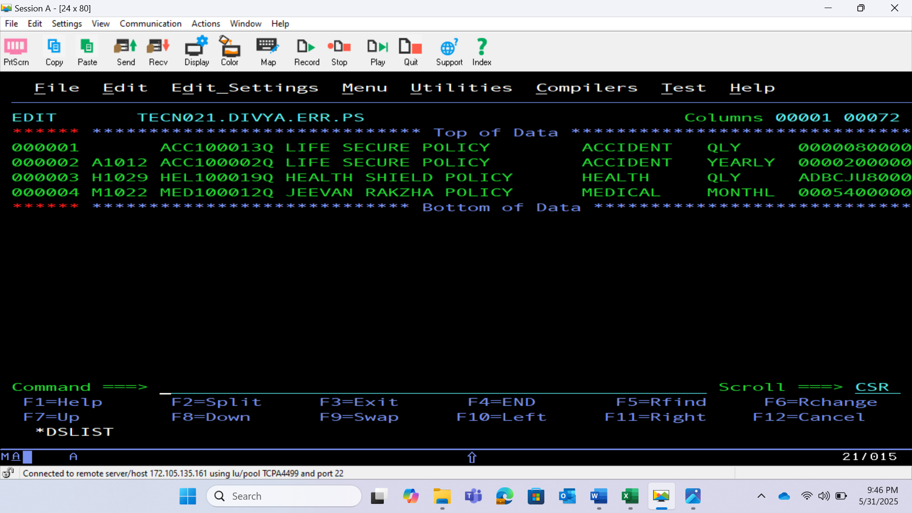
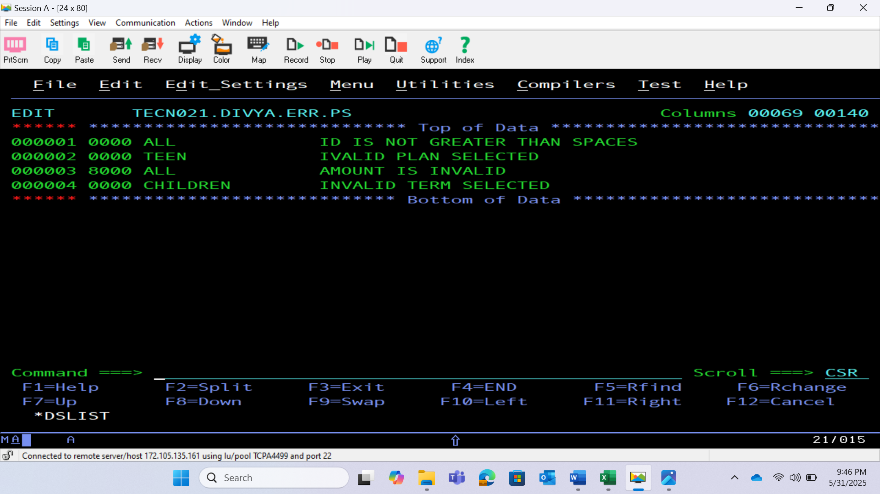
INSURANCE POLICY ERROR FILE

Slide 12
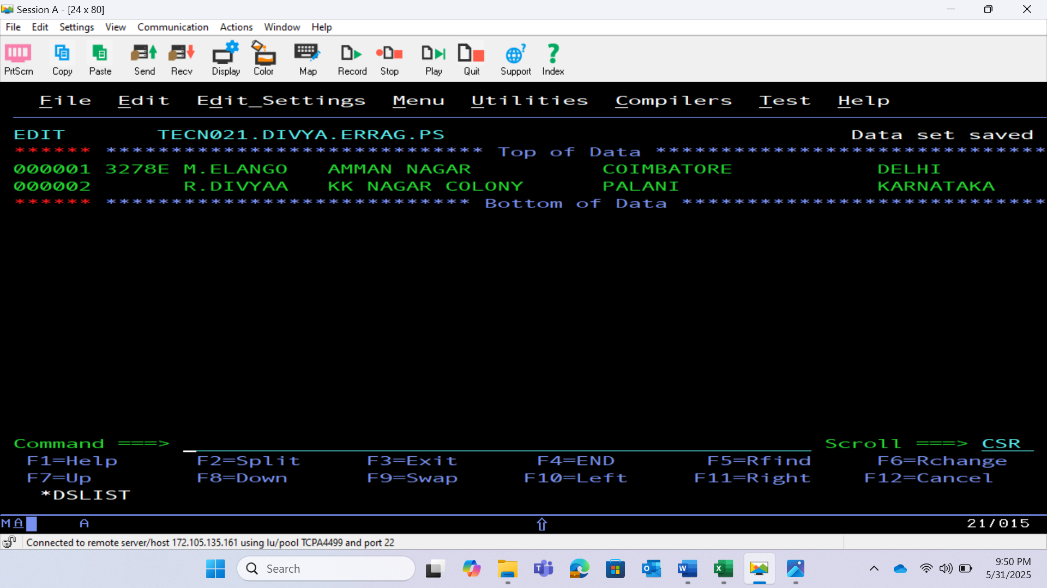
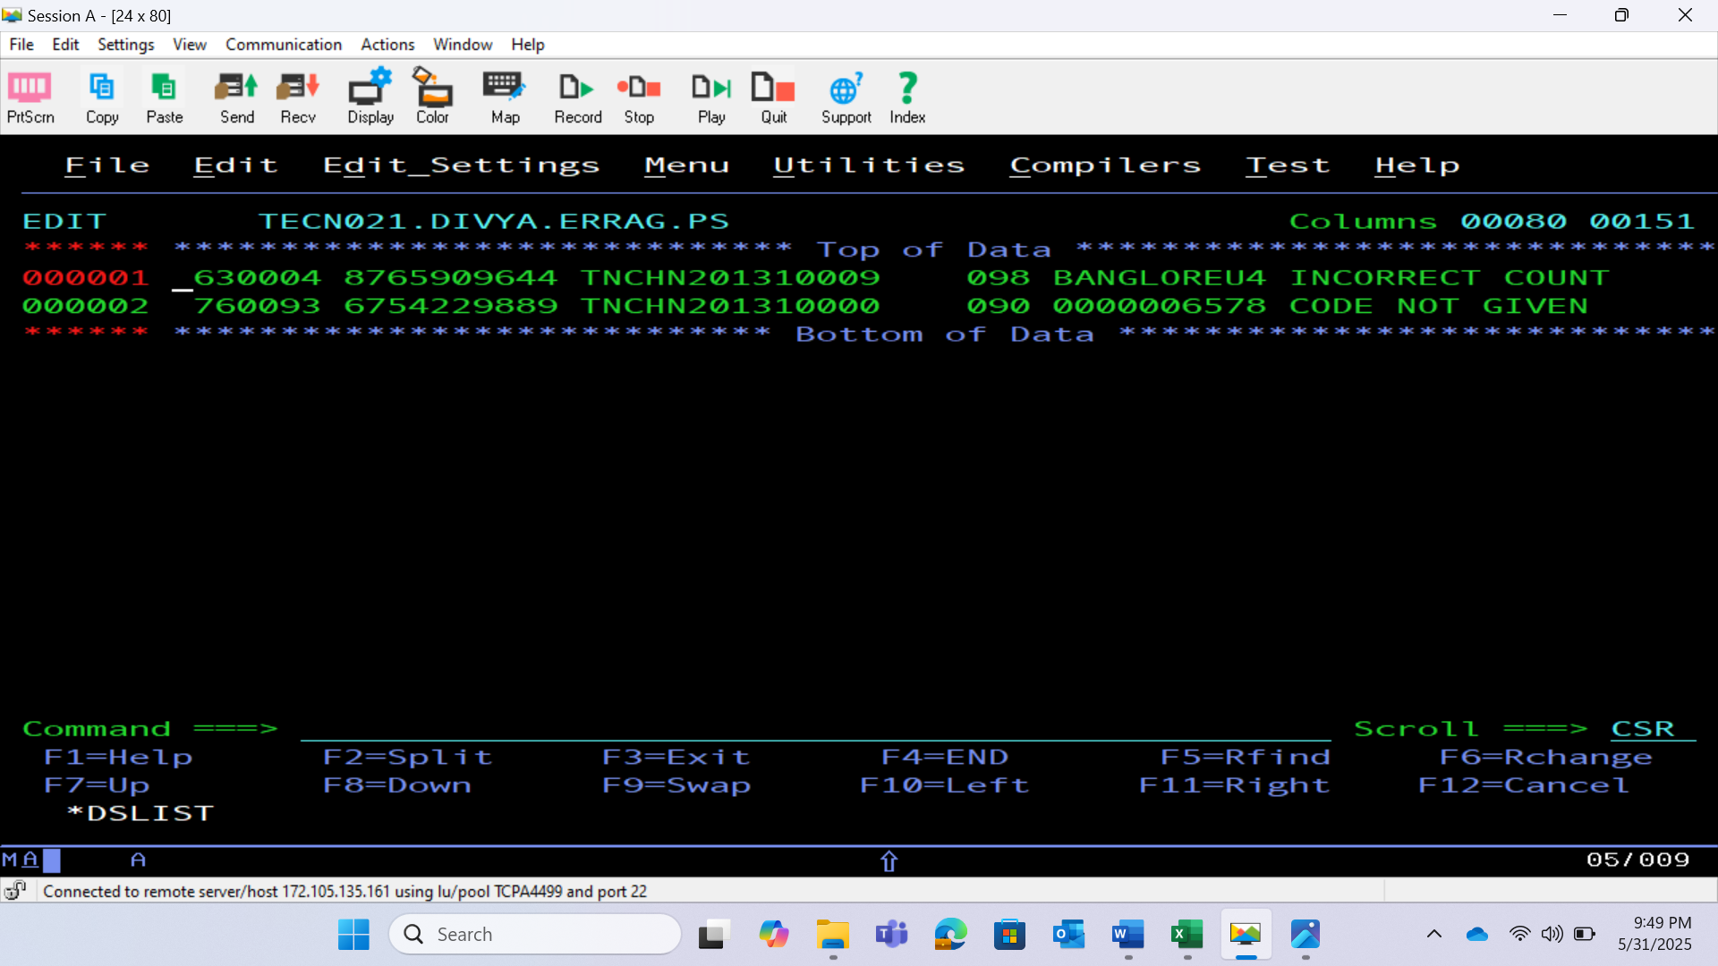
AGENT DETAILS ERROR FILE

Slide 13
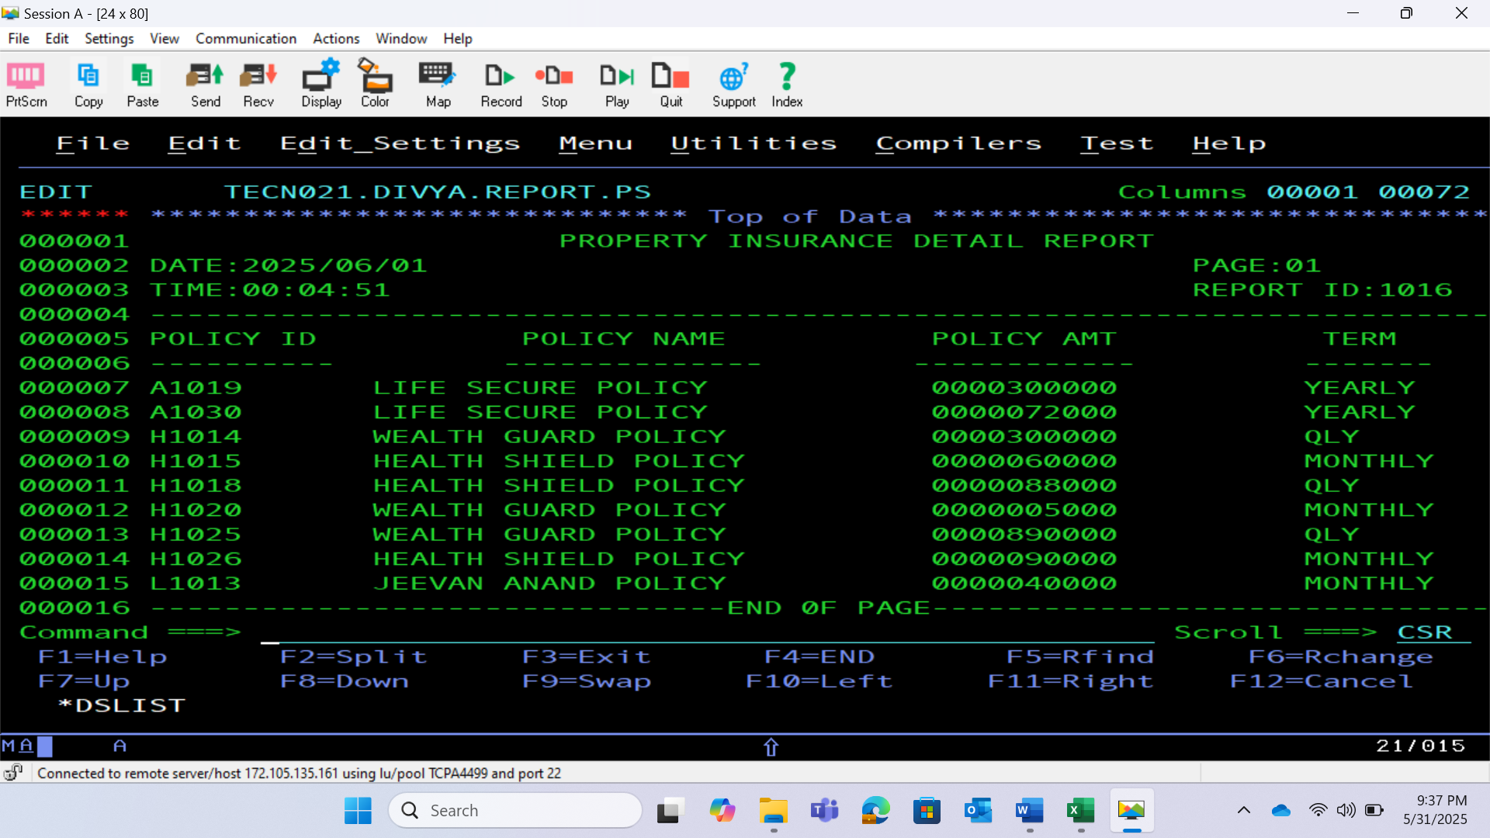
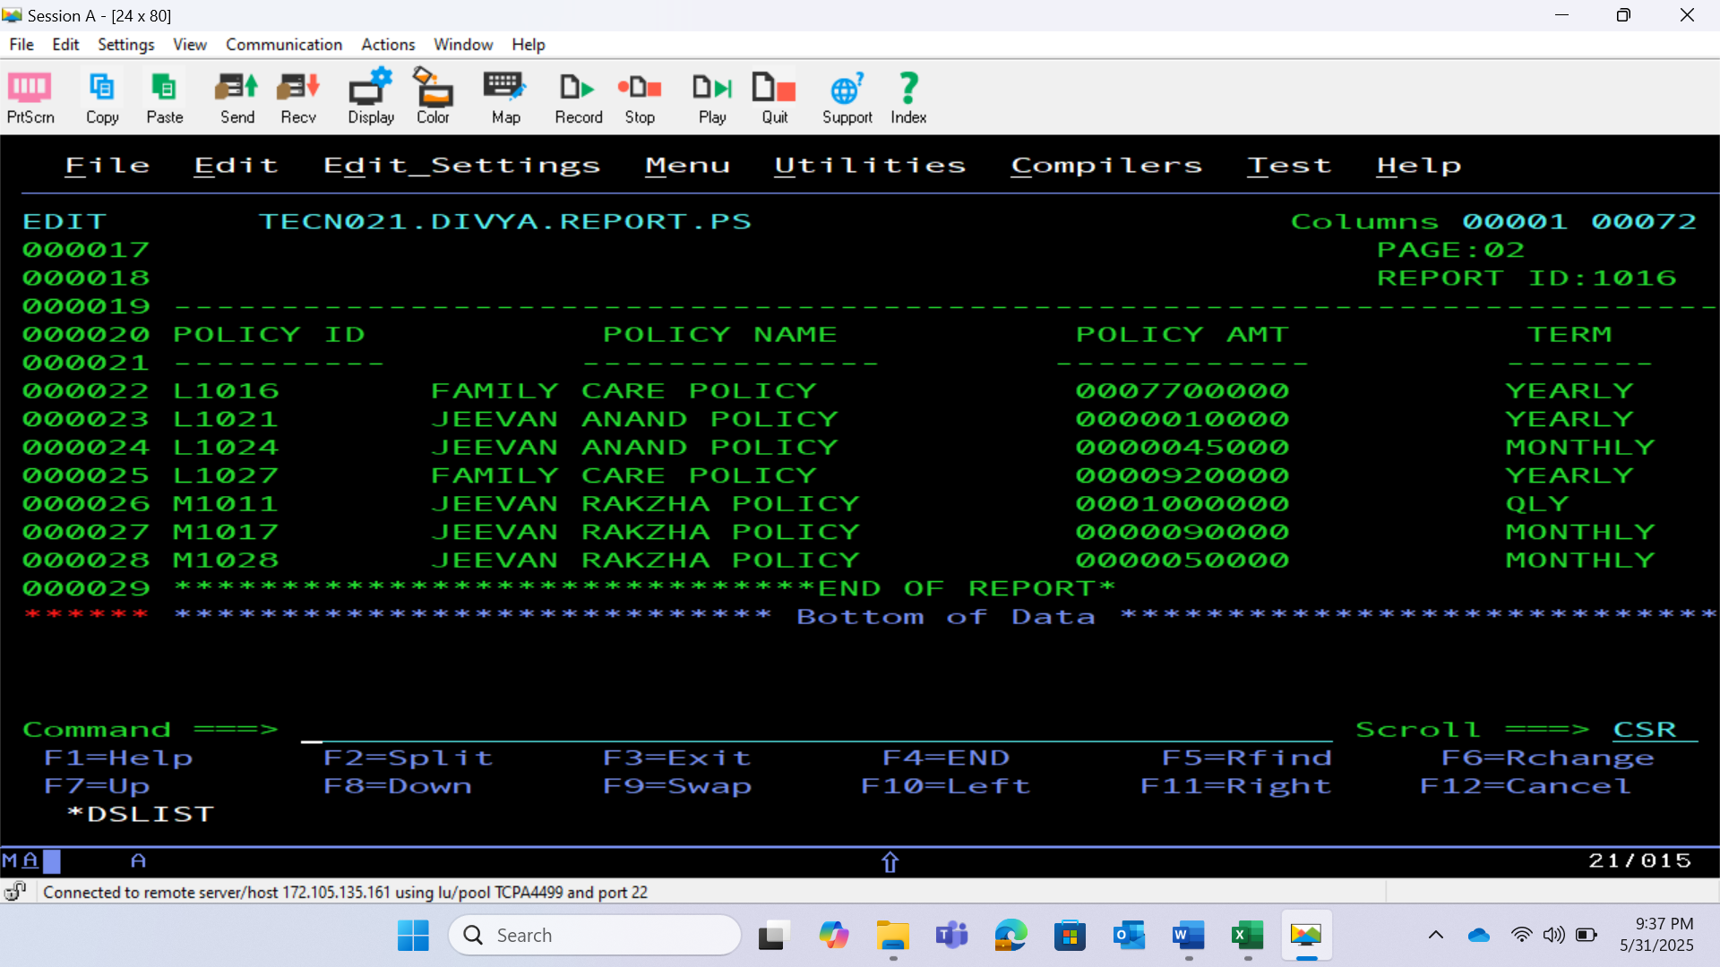
REPORT FILE

Slide 14
THANK YOU

